Slide 1
Project Costings

Slide 2
Motivation
The software cost estimation provides:
the vital link between the general concepts and techniques of economic analysis and the particular world of software engineering.
Software cost estimation techniques also provides an essential part of the foundation for good software management.

Slide 3
Cost of a project
The cost in a project is due to:
due the requirements for software, hardware and human resources
the cost of software development is due to the human resources needed
most cost estimates are measured in person-months (PM)

Slide 4
Cost of a project (.)
the cost of the project depends on the nature and characteristics of the project, at any point, the accuracy of the estimate will depend on the amount of reliable information we have about the final product.

Slide 5
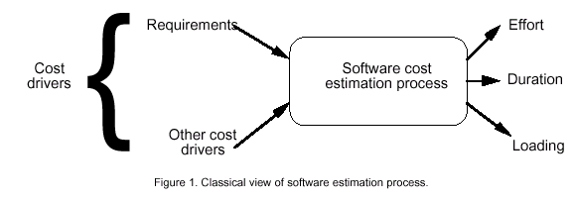
Software Cost Estimation

Slide 6
Introduction to COCOMO models
The COstructive COst Model (COCOMO) is the most widely used software estimation model in the world. It
The COCOMO model predicts the effort and duration of a project based on inputs relating to the size of the resulting systems and a number of "cost drives" that affect productivity.

Slide 7
Effort
Effort Equation
PM = C * (KDSI)^{n} (person-months)
where PM = number of person-month (=152 working hours),
C = a constant,
KDSI = thousands of "delivered source instructions" (DSI) and
n = a constant.

Slide 8
Productivity
Productivity equation
(DSI) / (PM)
where PM = number of person-month (=152 working hours),
DSI = "delivered source instructions"

Slide 9
Schedule
Schedule equation
TDEV = C * (PM)^{n} (months)
where TDEV = number of months estimated for software development.

Slide 10
Average Staffing
Average Staffing Equation
(PM) / (TDEV) (FSP)
where FSP means Full-time-equivalent Software Personnel.

Slide 11
COCOMO Models
COCOMO is defined in terms of three different models:
the Basic model,
the Intermediate model, and
the Detailed model.
The more complex models account for more factors that influence software projects, and make more accurate estimates.

Slide 12
The Development mode
the most important factors contributing to a project's duration and cost is the Development Mode
Organic Mode: The project is developed in a familiar, stable environment, and the product is similar to previously developed products. The product is relatively small, and requires little innovation.
Semidetached Mode: The project's characteristics are intermediate between Organic and Embedded.

Slide 13
The Development mode
the most important factors contributing to a project's duration and cost is the Development Mode:
Embedded Mode: The project is characterized by tight, inflexible constraints and interface requirements. An embedded mode project will require a great deal of innovation.

Slide 14
Modes

Slide 15
Modes (.)

Slide 16
Cost Estimation Process
Cost=SizeOfTheProject x Productivity

Slide 17
Cost Estimation Process
Effort
Size Table
Lines of Code
Number of Use Case
Function Point
Development Time
Estimation Process
Number of Personnel
Errors

Slide 18
Project Size - Metrics
Number of functional requirements
Cumulative number of functional and non-functional requirements
Number of Customer Test Cases
Number of ‘typical sized’ use cases
Number of inquiries
Number of files accessed (external, internal, master)
Total number of components (subsystems, modules, procedures, routines, classes, methods)
Total number of interfaces
Number of System Integration Test Cases
Number of input and output parameters (summed over each interface)
Number of Designer Unit Test Cases
Number of decisions (if, case statements) summed over each routine or method
Lines of Code, summed over each routine or method

Slide 19
Project Size – Metrics(.)
Availability of Size Estimation Metrics:
Development Phase
Available
Metrics
a
Requirements Gathering
1, 2, 3
b
Requirements Analysis
4, 5
d
High Level Design
6, 7, 8, 9
e
Detailed Design
10, 11, 12
f
Implementation
12, 13

Slide 20
Function Points
STEP 1: measure size in terms of the amount of functionality in a system. Function points are computed by first calculating an unadjusted function point count (UFC). Counts are made for the following categories
•External inputs – those items provided by the user that describe distinct application-oriented data (such as file names and menu selections)
•External outputs – those items provided to the user that generate distinct application-oriented data (such as reports and messages, rather than the individual components of these)

Slide 21
Function Points(.)
• External inquiries – interactive inputs requiring a response
• External files – machine-readable interfaces to other systems
• Internal files – logical master files in the system

Slide 22
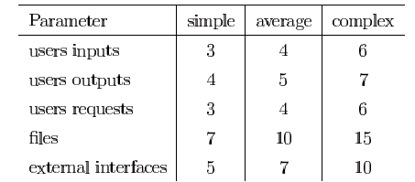
Function Points(..)
STEP 2: Multiply each number by a weight factor, according to complexity (simple, average or complex) of the parameter, associated with that number. The value is given by a table:

Slide 23
Function Points(...)
STEP 3: Calculate the total UFP (Unadjusted Function Points)
STEP 4: Calculate the total TCF (Technical Complexity Factor) by giving a value between 0 and 5 according to the importance of the following points:

Slide 24
Function Points(....)
Technical Complexity Factors:
1. Data Communication
2. Distributed Data Processing
3. Performance Criteria
4. Heavily Utilized Hardware
5. High Transaction Rates
6. Online Data Entry
7. Online Updating
8. End-user Efficiency
9. Complex Computations
10. Reusability
11. Ease of Installation
12. Ease of Operation
13. Portability
14. Maintainability

Slide 25
Function Points(.....)
STEP 5: Sum the resulting numbers too obtain DI (degree of influence)
STEP 6: TCF (Technical Complexity Factor) by given by the formula
TCF=0.65+0.01*DI
STEP 6: Function Points are by given by the formula
FP=UFP*TCF

Slide 26
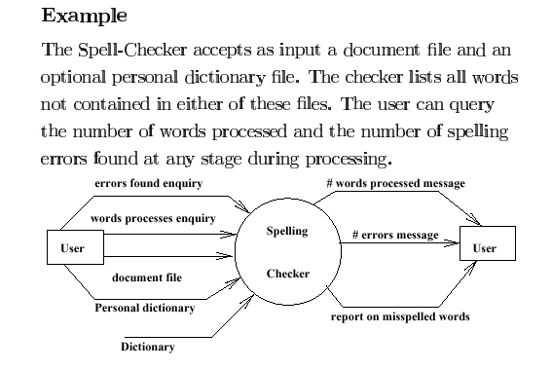
Example

Slide 27
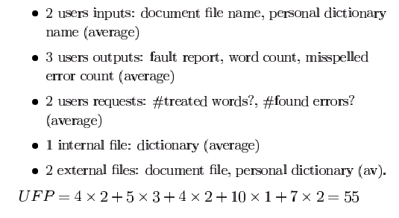
Example (.)

Slide 28
Example (..)
Technical Complexity Factors:
1. Data Communication 3
2. Distributed Data Processing 0
3. Performance Criteria 4
4. Heavily Utilized Hardware 0
5. High Transaction Rates 3
6. Online Data Entry 3
7. Online Updating 3
8. End-user Efficiency 3
9. Complex Computations 0
10. Reusability 3
11. Ease of Installation 3
12. Ease of Operation 5
13. Portability 3
14. Maintainability 3
DI =30 (Degree of Influence)

Slide 29
Example (…)
Function Points
FP=UFP*(0.65+0.01*DI)= 55*(0.65+0.01*30)=52.25
That means the is FP=52.25

Slide 30
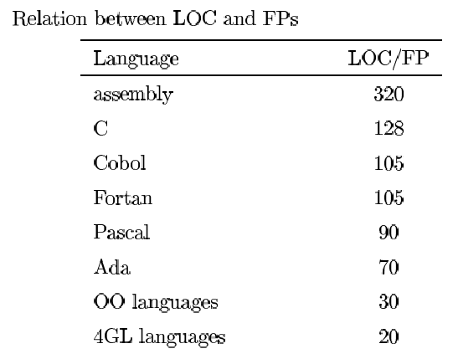
Relation between LOC and FP
Relationship:
LOC = Language Factor * FP
where
LOC (Lines of Code)
FP (Function Points)

Slide 31
Relation between LOC and FP(.)
Assuming LOC’s per FP for:
Java = 53,
C++ = 64
aKLOC = FP * LOC_per_FP / 1000
It means for the SpellChekcer Example: (Java)
LOC=52.25*53=2769.25 LOC or 2.76 KLOC

Slide 32
Effort Computation
The Basic COCOMO model computes effort as a function of program size. The Basic COCOMO equation is:
E = aKLOC^b
Effort for three modes of Basic COCOMO.
Mode | a | b
Organic | 2.4 | 1.05
Semi-detached | 3.0 | 1.12
Embedded | 3.6 | 1.20

Slide 33

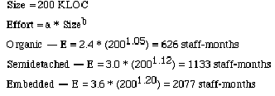
Example

Slide 34
Effort Computation
The intermediate COCOMO model computes effort as a function of program size and a set of cost drivers. The Intermediate COCOMO equation is:
E = aKLOC^b*EAF
Effort for three modes of intermediate COCOMO.
Mode | a | b
Organic | 3.2 | 1.05
Semi-detached | 3.0 | 1.12
Embedded | 2.8 | 1.20

Slide 35
Effort computation(.)
Effort Adjustment Factor
Cost Driver
Very
Low
Low
Nominal
High
Very
High
Extra
High
Required Reliability
.75
.88
1.00
1.15
1.40
1.40
Database Size
.94
.94
1.00
1.08
1.16
1.16
Product Complexity
.70
.85
1.00
1.15
1.30
1.65
Execution Time Constraint
1.00
1.00
1.00
1.11
1.30
1.66
Main Storage Constraint
1.00
1.00
1.00
1.06
1.21
1.56
Virtual Machine Volatility
.87
.87
1.00
1.15
1.30
1.30
Comp Turn Around Time
.87
.87
1.00
1.07
1.15
1.15
Analyst Capability
1.46
1.19
1.00
.86
.71
.71
Application Experience
1.29
1.13
1.00
.91
.82
.82
Programmers Capability
1.42
1.17
1.00
.86
.70
.70
Virtual machine Experience
1.21
1.10
1.00
.90
.90
.90
Language Experience
1.14
1.07
1.00
.95
.95
.95
Modern Prog Practices
1.24
1.10
1.00
.91
.82
.82
SW Tools
1.24
1.10
1.00
.91
.83
.83
Required Dev Schedule
1.23
1.08
1.00
1.04
1.10
1,10

Slide 36
Effort Computation (..)
Total EAF = Product of the selected factors
Adjusted value of Effort: Adjusted Person Months:
APM = (Total EAF) * PM

Slide 37


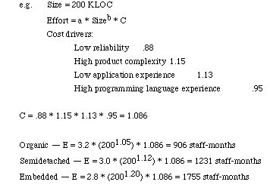
Example

Slide 38
Software Development Time
Development Time Equation Parameter Table:
Development Time, TDEV = C * (APM **D)
Number of Personnel, NP = APM / TDEV
Parameter | Organic | Semi-detached | Embedded
C | 2.5 | 2.5 | 2.5
D | 0.38 | 0.35 | 0.32

Slide 39
Distribution of Effort
A development process typically consists of the following stages:
- Requirements Analysis
- Design (High Level + Detailed)
- Implementation & Coding
- Testing (Unit + Integration)

Slide 40
Distribution of Effort (.)
The following table gives the recommended percentage distribution of Effort (APM) and TDEV for these stages:
Percentage Distribution of Effort and Time Table:
Req Analysis
Design, HLD + DD
Implementation
Testing
Effort
23%
29%
22%
21%
100%
TDEV
39%
25%
15%
21%
100%

Slide 41
Error Estimation
Calculate the estimated number of errors in your design, i.e.total errors found in requirements, specifications, code, user manuals, and bad fixes:
Adjust the Function Point calculated in step1
AFP = FP ** 1.25
Use the following table for calculating error estimates
Error Type | Error / AFP
Requirements | 1
Design | 1.25
Implementation | 1.75
Documentation | 0.6
Due to Bug Fixes | 0.4

